Slide 1
Web Programming Lecture 20
Introduction to MySQL

Slide 2
Relational Databases
Relational databases model data by storing rows and columns in tables. The power of the relational database lies in its ability to efficiently retrieve data from those tables and in particular where there are multiple tables and the relationships between those tables involved in the query.
http://en.wikipedia.org/wiki/Relational_database

Slide 3
Terminology
Database - Contains many tables
Relation (or table) - contains tuples and attributes
Tuple (or row) - is a set of fields it generally represents an “object”
like a person or a music track
Attribute (also column or field) - One of possibly many elements of
data corresponding to the object represented by the row

Slide 4
SQL
Structured Query Language is the language we use to issue commands to the database
Create a table
Retrieve some data
Insert data
Delete data
http://en.wikipedia.org/wiki/SQL

Slide 5




Application Structure
Application Software
Database Data Model
End User
SQL
SQL
Database Tools
DB

Slide 6
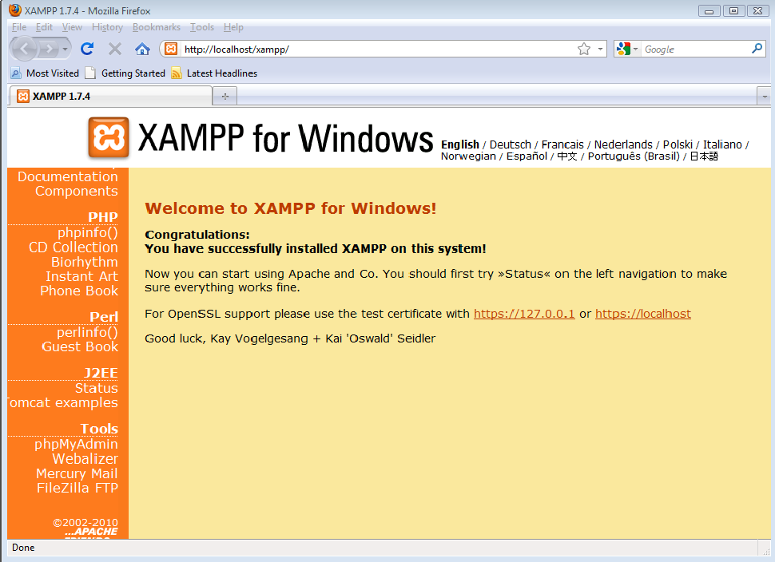
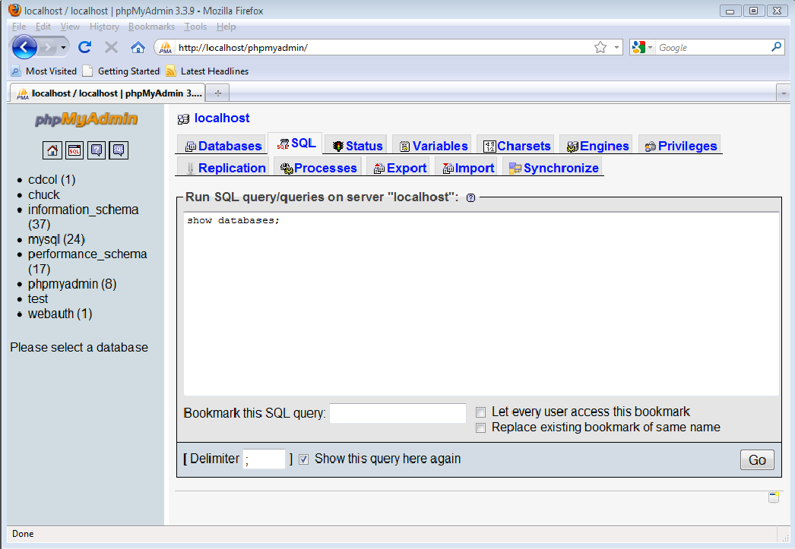
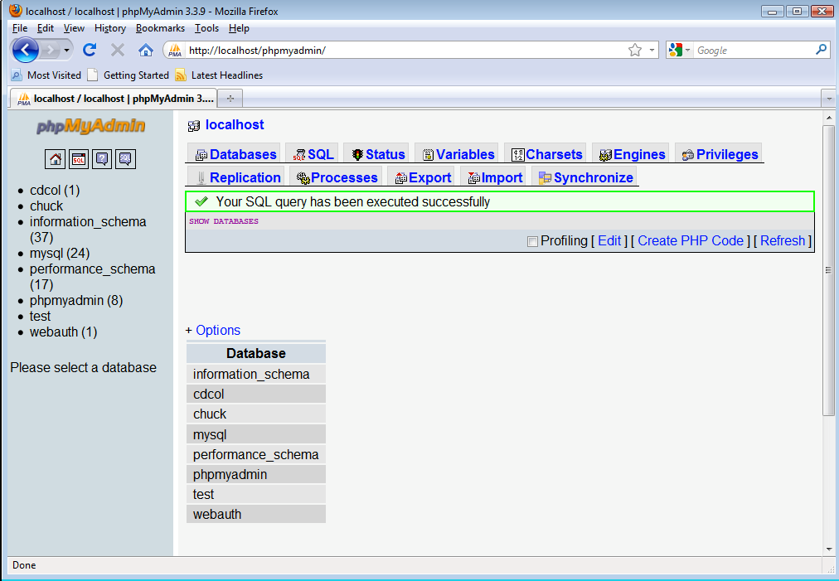

Slide 7
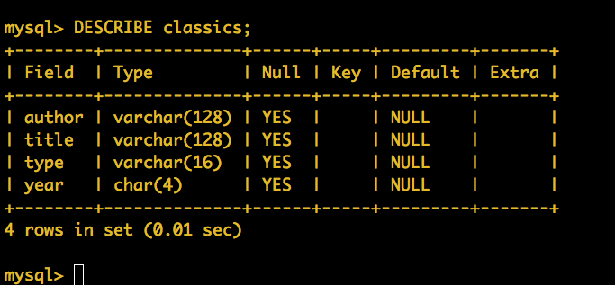
Creating a Table
CREATE TABLE classics ( author VARCHAR(128), title VARCHAR(128), type VARCHAR(16),
year CHAR(4))
ENGINE MyISAM;
DESCRIBE classics;

Slide 8
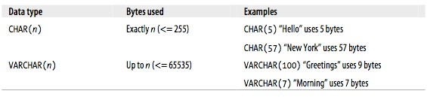
Text Fields
Understand character sets and indexable for searching
CHAR allocates entire space (faster for small strings where length is
known)
VARCHAR allocates variable amount of space depending on the data
length (less space)

Slide 9
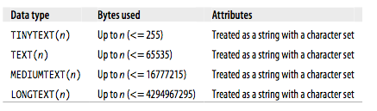
Text Fields
Have a character set

Slide 10

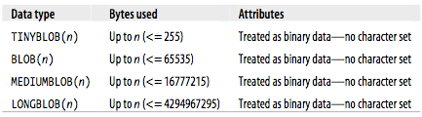
Binary Large Object (BLOB)
Large raw data, files, images, word documents, PDF, Movies, etc etc..
No translation, indexing or character set
http://www.youtube.com/watch?v=XhyRpvgm03g

Slide 11
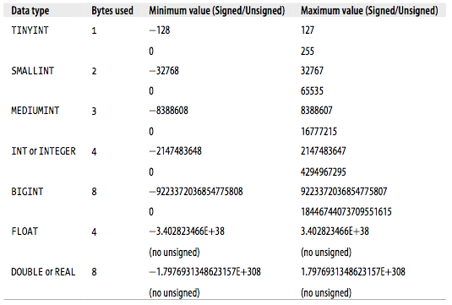
Numbers
Numbers are very
efficient, take little storage and are easy to
process because CPU's can compare them
often with a single instruction
32 bit
64 bit

Slide 12
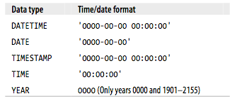
Dates
TIMESTAMP is very efficient but only can handle dates from
1970 through 2037
32 bit

Slide 13
AUTO_INCREMENT
DROP TABLE classics;
CREATE TABLE classics (
id INT UNSIGNED NOT NULL AUTO_INCREMENT KEY,
author VARCHAR(128),
title VARCHAR(128), type VARCHAR(16),
year CHAR(4))
ENGINE MyISAM;
DESCRIBE classics;
Often as we make multiple
tables and need to JOIN them together we need an integer, primary key for each row so we can efficiently add a reference to a row in a table, in
some other table as a foreign key

Slide 14
Inserting...
INSERT INTO classics(author,
title, type, year)
VALUES('Mark Twain','The Adventures of Tom Sawyer','Fiction','1876'); INSERT INTO classics(author, title, type, year)
VALUES('Jane Austen','Pride and Prejudice','Fiction','1811'); INSERT INTO classics(author, title, type, year)
VALUES('Charles Darwin','The Origin of Species','Non-Fiction','1856'); INSERT INTO classics(author, title, type, year)
VALUES('Charles Dickens','The Old Curiosity Shop','Fiction','1841'); INSERT INTO classics(author, title, type, year)
VALUES('William Shakespeare','Romeo and Juliet','Play','1594');

Slide 15
Inserted...
mysql> select * from classics;
+----+---------------------+------------------------------+-------------+------+
| id | author | title | type | year |
+----+---------------------+------------------------------+-------------+------+
| | 1 | | | Mark Twain | | | The Adventures of Tom Sawyer | | | Fiction | | | 1876 |
| | 2 | | | Jane Austen | | | Pride and Prejudice | | | Fiction | | | 1811 |
| | 3 | | | Charles Darwin | | | The Origin of Species | | | Non-Fiction | | | 1856 |
| | 4 | | | Charles Dickens | | | The Old Curiosity Shop | | | Fiction | | | 1841 |
| | 5 | | | William Shakespeare | | | Romeo and Juliet | | | Play | | | 1594 |
+----+---------------------+------------------------------+-------------+------+
5 rows in set (0.00 sec)
mysql>

Slide 16
mysql> describe classics;
+--------+------------------+------+-----+---------+----------------+
| Field | Type | Null | Key | Default | Extra |
+--------+------------------+------+-----+---------+----------------+
| id | int(10) unsigned | NO | PRI | NULL | auto_increment |
| author | varchar(128)
| YES |
| YES |
| YES |
| YES |
| NULL
| NULL
| NULL
| NULL
|
|
|
|
|
|
|
|
| title
| type
| year
| varchar(128)
| varchar(16)
| char(4)
+--------+------------------+------+-----+---------+----------------+
5 rows in set (0.00 sec)
mysql> ALTER TABLE classics MODIFY year SMALLINT; Query OK, 5 rows affected (0.08 sec)
Records: 5 Duplicates: 0 Warnings: 0
mysql> describe classics;
+--------+------------------+------+-----+---------+----------------+
| Field | Type | Null | Key | Default | Extra |
+--------+------------------+------+-----+---------+----------------+
| id | int(10) unsigned | NO | PRI | NULL | auto_increment |
| author | varchar(128)
| YES |
| YES |
| YES |
| YES |
| NULL
| NULL
| NULL
| NULL
|
|
|
|
|
|
|
|
| title
| type
| year
| varchar(128)
| varchar(16)
| smallint(6)
+--------+------------------+------+-----+---------+----------------+

Slide 17
mysql> ALTER TABLE classics ADD pages SMALLINT; Query OK, 5 rows affected (0.12 sec)
Records: 5 Duplicates: 0 Warnings: 0
mysql> describe classics;
+--------+------------------+------+-----+---------+----------------+
| Field | Type | Null | Key | Default | Extra |
+--------+------------------+------+-----+---------+----------------+
| id | int(10) unsigned
| NO | PRI | NULL | auto_increment |
| YES |
| YES |
| YES |
| YES |
| YES |
| author | varchar(128)
| NULL
| NULL
| NULL
| NULL
| NULL
|
|
|
|
|
|
|
|
|
|
| title
| type
| year
| pages
| varchar(128)
| varchar(16)
| smallint(6)
| smallint(6)
+--------+------------------+------+-----+---------+----------------+
6 rows in set (0.08 sec)
mysql>

Slide 18
Indexes
As a table gets large (they always do) scanning all the data to find a
single row becomes very costly
When u_saeed@msn.com logs into FaceBook, they must find my
password amongst 1000-million users
There are techniques to greatly shorten the scan as long as you create data structures and maintain those structures - like shortcuts
Hashes or Trees

Slide 19
MySQL Index Types
PRIMARY KEY - Very little space, very very fast, exact match, requires
no duplicates, extremely fast for integer fields
INDEX - Good for individual row lookup and sorting / grouping
results - works best with exact matches or prefix lookups
FULLTEXT - Costly to maintain on insert of new data, can handle
substrings and the LIKE clause

Slide 20
Retrieving rows with SELECT
mysql> select * from classics;
+----+---------------------+------------------------------+-------------+------+-------+
| id | author | title | type | year | pages |
+----+---------------------+------------------------------+-------------+------+-------+
| 1 | Mark Twain
| 2 | Jane Austen
| 3 | Charles Darwin
| 4 | Charles Dickens
|
| The Adventures of Tom Sawyer | Fiction | 1876 |
NULL | NULL | NULL |
NULL | NULL |
| Pride and Prejudice
| The Origin of Species
| The Old Curiosity Shop
| Fiction | 1811 |
| Non-Fiction | 1856 |
| Fiction
| Play
| 1841 |
| 1594 |
5 | William Shakespeare | Romeo and Juliet
+----+---------------------+------------------------------+-------------+------+-------+
5 rows in set (0.00 sec)
mysql>

Slide 21
Retrieving rows with SELECT
mysql> select title, year from classics;
+------------------------------+------+
| title | year |
+------------------------------+------+
| The Adventures of Tom Sawyer | 1876 |
| Pride and Prejudice
| The Origin of Species
| The Old Curiosity Shop
| 1811 |
| 1856 |
| 1841 |
| Romeo and Juliet | 1594 |
+------------------------------+------+
5 rows in set (0.00 sec)
mysql>

Slide 22
Counting with SELECT
mysql> select count(*) from classics;
+----------+
| count(*) |
+----------+
| 5 |
+----------+
1 row in set (0.00 sec)
mysql>

Slide 23
WHERE Clause
We can limit the rows we retrieve on a SELECT using a WHERE
clause
mysql> SELECT title, author, year FROM classics WHERE year > 1850;
+------------------------------+----------------+------+
| title | author | year |
+------------------------------+----------------+------+
| The Adventures of Tom Sawyer | Mark Twain | 1876 |
| The Origin of Species | Charles Darwin | 1856 |
+------------------------------+----------------+------+
2 rows in set (0.00 sec)
mysql>

Slide 24
The LIKE clause
We can do wildcard matching in a WHERE clause using the LIKE
operator
mysql> SELECT title, author FROM classics WHERE title LIKE "%and%";
+---------------------+---------------------+
| title | author |
+---------------------+---------------------+
| Pride and Prejudice | Jane Austen |
| Romeo and Juliet | William Shakespeare |
+---------------------+---------------------+
2 rows in set (0.00 sec)
mysql>

Slide 25
ORDER BY
mysql> SELECT title, author, year FROM classics ORDER BY year;
+------------------------------+---------------------+------+
| title | author | year |
+------------------------------+---------------------+------+
| | Romeo and Juliet | | | William Shakespeare | | | 1594 | |
| | Pride and Prejudice | | | Jane Austen | | | 1811 | |
| | The Old Curiosity Shop | | | Charles Dickens | | | 1841 | |
| | The Origin of Species | | | Charles Darwin | | | 1856 | |
| | The Adventures of Tom Sawyer | | | Mark Twain | | | 1876 | |
+------------------------------+---------------------+------+
5 rows in set (0.00 sec)
mysql>

Slide 26
ORDER BY
mysql> SELECT title, author, year FROM classics ORDER BY year DESC;
+------------------------------+---------------------+------+
| title | author | year |
+------------------------------+---------------------+------+
| | The Adventures of Tom Sawyer | | | Mark Twain | | | 1876 | |
| | The Origin of Species | | | Charles Darwin | | | 1856 | |
| | The Old Curiosity Shop | | | Charles Dickens | | | 1841 | |
| | Pride and Prejudice | | | Jane Austen | | | 1811 | |
| | Romeo and Juliet | | | William Shakespeare | | | 1594 | |
+------------------------------+---------------------+------+
5 rows in set (0.00 sec)
mysql>
Indexes improve ORDER BY performance.

Slide 27
The LIMIT Clause
The LIMIT clause can request the first "n" rows, or the first "n" rows
after some starting row. Note: the first row is zero, not one
WHERE and ORDER BY clauses happen *before* the LIMIT is applied
mysql> SELECT title, author, year FROM classics ORDER BY year DESC LIMIT 2;
+------------------------------+----------------+------+
| title | author | year |
+------------------------------+----------------+------+
| The Adventures of Tom Sawyer | Mark Twain | 1876 |
| The Origin of Species | Charles Darwin | 1856 |
+------------------------------+----------------+------+
2 rows in set (0.01 sec)

Slide 28
The LIMIT Clause
The LIMIT clause can request the first "n" rows, or the first "n" rows
after some starting row. Note: the first row is zero, not one
WHERE and ORDER BY clauses happen *before* the LIMIT is applied
mysql> SELECT title, author, year FROM classics ORDER BY year DESC LIMIT 1,2;
+------------------------+-----------------+------+
| title | author | year |
+------------------------+-----------------+------+
| The Origin of Species | Charles Darwin | 1856 |
| The Old Curiosity Shop | Charles Dickens | 1841 |
+------------------------+-----------------+------+
2 rows in set (0.00 sec)

Slide 29
UPDATE .. SET
Allows the updating of one or more columns in a row or set of rows
Usually used with a WHERE clause
mysql> SELECT * FROM tweet;
+----------------+-------+
| text | zip |
+----------------+-------+
| Had pizza
| Had Chi Dog
| Went to 572
| 48842 |
| 48109 |
| 48109 |
| Coding at home | 48842 |
+----------------+-------+

Slide 30
mysql> UPDATE tweet SET zip='49277' WHERE text = 'Had pizza'; Query OK, 1 row affected (0.00 sec)
Rows matched: 1 Changed: 1 Warnings: 0
mysql> SELECT * FROM tweet;
+----------------+-------+
| text | zip |
+----------------+-------+
| Had pizza
| Had Chi Dog
| Went to 572
| 49277 |
| 48109 |
| 48109 |
| Coding at home | 48842 |
+----------------+-------+

Slide 31
Summary
We have whipped through the basics of using MySQL
Table creating and maintenance
Data types
Indexes
SQL operations

